Slide 1

Pokémon Battle Simulator
Human Computer Interaction
Luigi Ariano
Edoardo Bonanni
Florence, 26 April 2022

Slide 2

Titolo presentazione
arial bold 8 pt
Luogo e data arial regular 8 pt
Introduction
Pokémon Battle Simulator is a game that aims to simulate the real Pokémon battle games. In the application are implemented all features and functionalities that allow the player to choose his team and play a match in singleplayer or multiplayer mode.
The game is basically divided in three parts: the first one allows you to choose all Pokémon for your team, the second one allows you to choose your nickname and the game mode and the last one consists of the real Pokémon battle that it can be played against the CPU or another Pokémon trainer.
Notes:
Our idea was to develop a Pokémon game in python that could run on any type of PC. We paid particular attention for the multiplayer mode as it was not cared for the classic Pokémon games, indeed it was difficult to find other gamers with whom to play to a real challenge between Pokémon trainers.

Slide 3
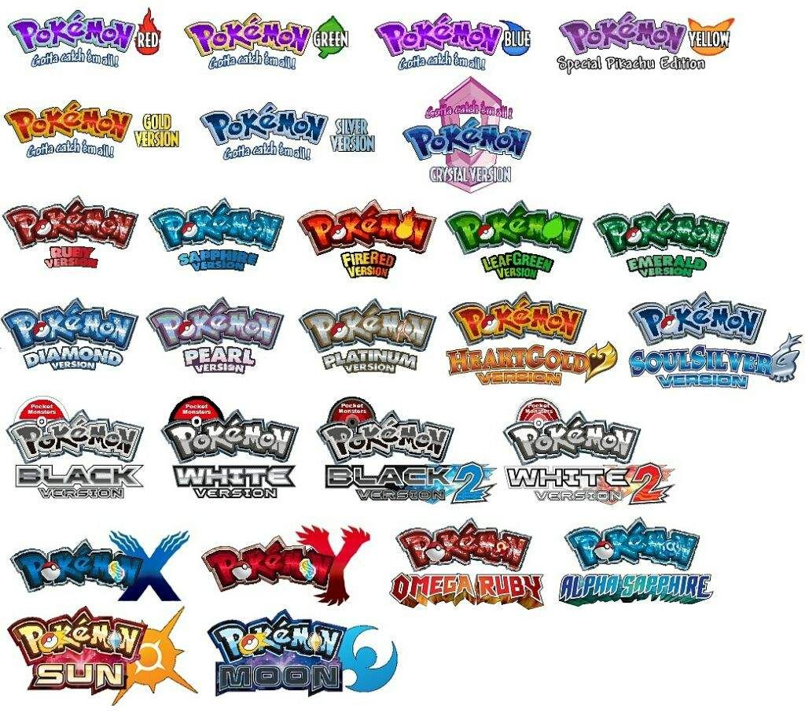
Titolo presentazione
arial bold 8 pt
Luogo e data arial regular 8 pt
Motivations
Pokémon games have always been owned by one of the most important and powerful game companies, namely Nintendo. Because of that, games have always been developed for certain types of consoles, all owned by Nintendo itself, limiting the possible players who can enjoy the various games.
Essentially, our idea was to develop a Pokémon game in python that could run on any type of PC and despite on the web there are several open-source Pokémon battle simulators, they have many bugs in them or a lack of graphical interface that doesn't allow the user to simulate a real battle as if he purchased the original game.
All obviously motivated by our passion for the Pokémon world that we have since we were little.
Notes:
Our idea was to develop a Pokémon game in python that could run on any type of PC. We paid particular attention for the multiplayer mode as it was not cared for the classic Pokémon games, indeed it was difficult to find other gamers with whom to play to a real challenge between Pokémon trainers.

Slide 4
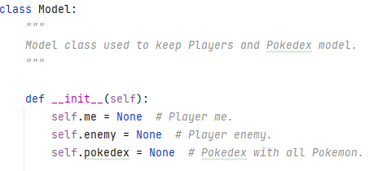
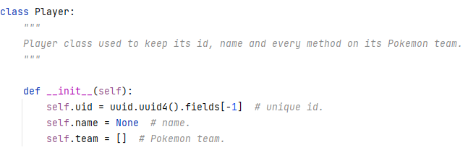
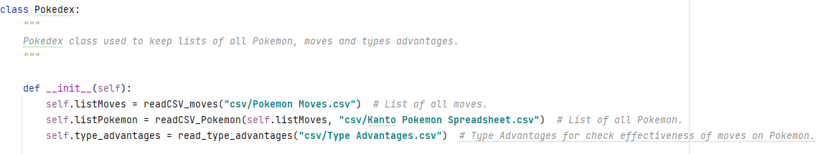
Titolo presentazione
arial bold 8 pt
Luogo e data arial regular 8 pt
Models – Model, Player and Pokédex classes

Slide 5
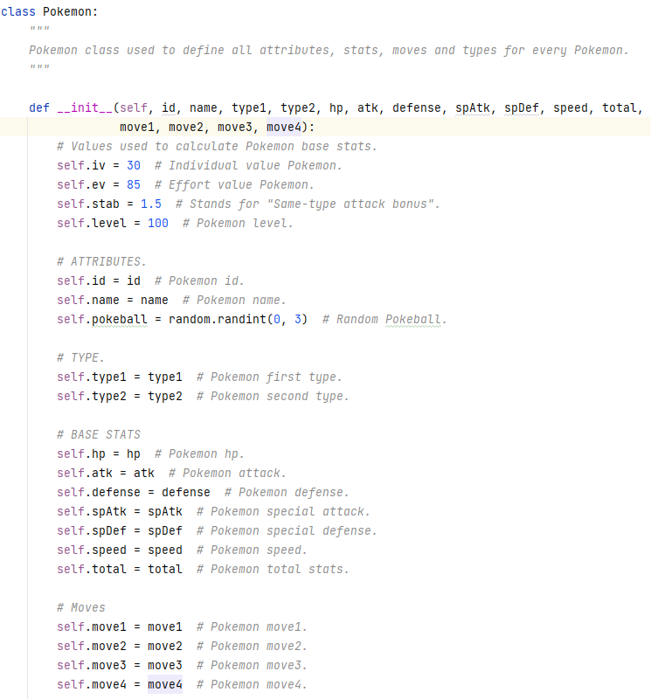
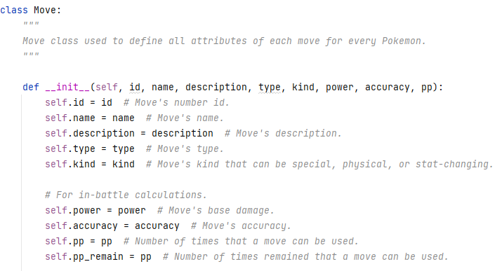
Titolo presentazione
arial bold 8 pt
Luogo e data arial regular 8 pt
Models – Pokémon and Move classes

Slide 6
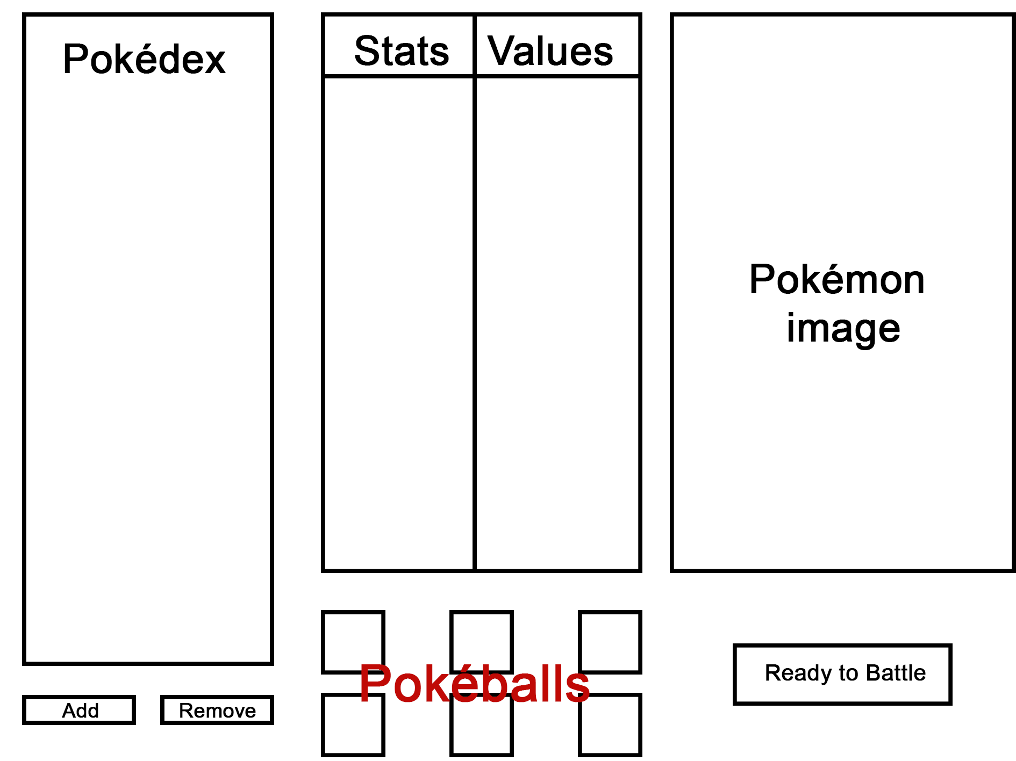
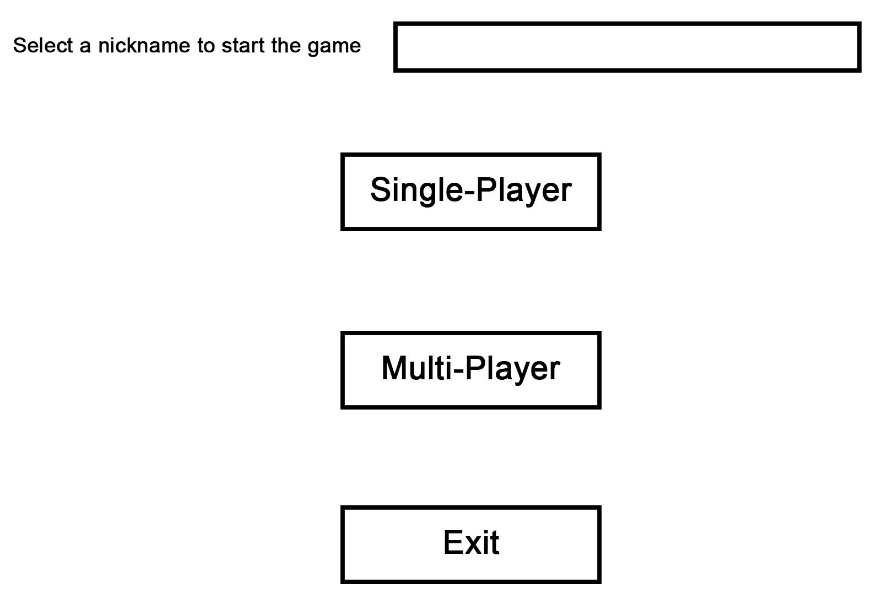
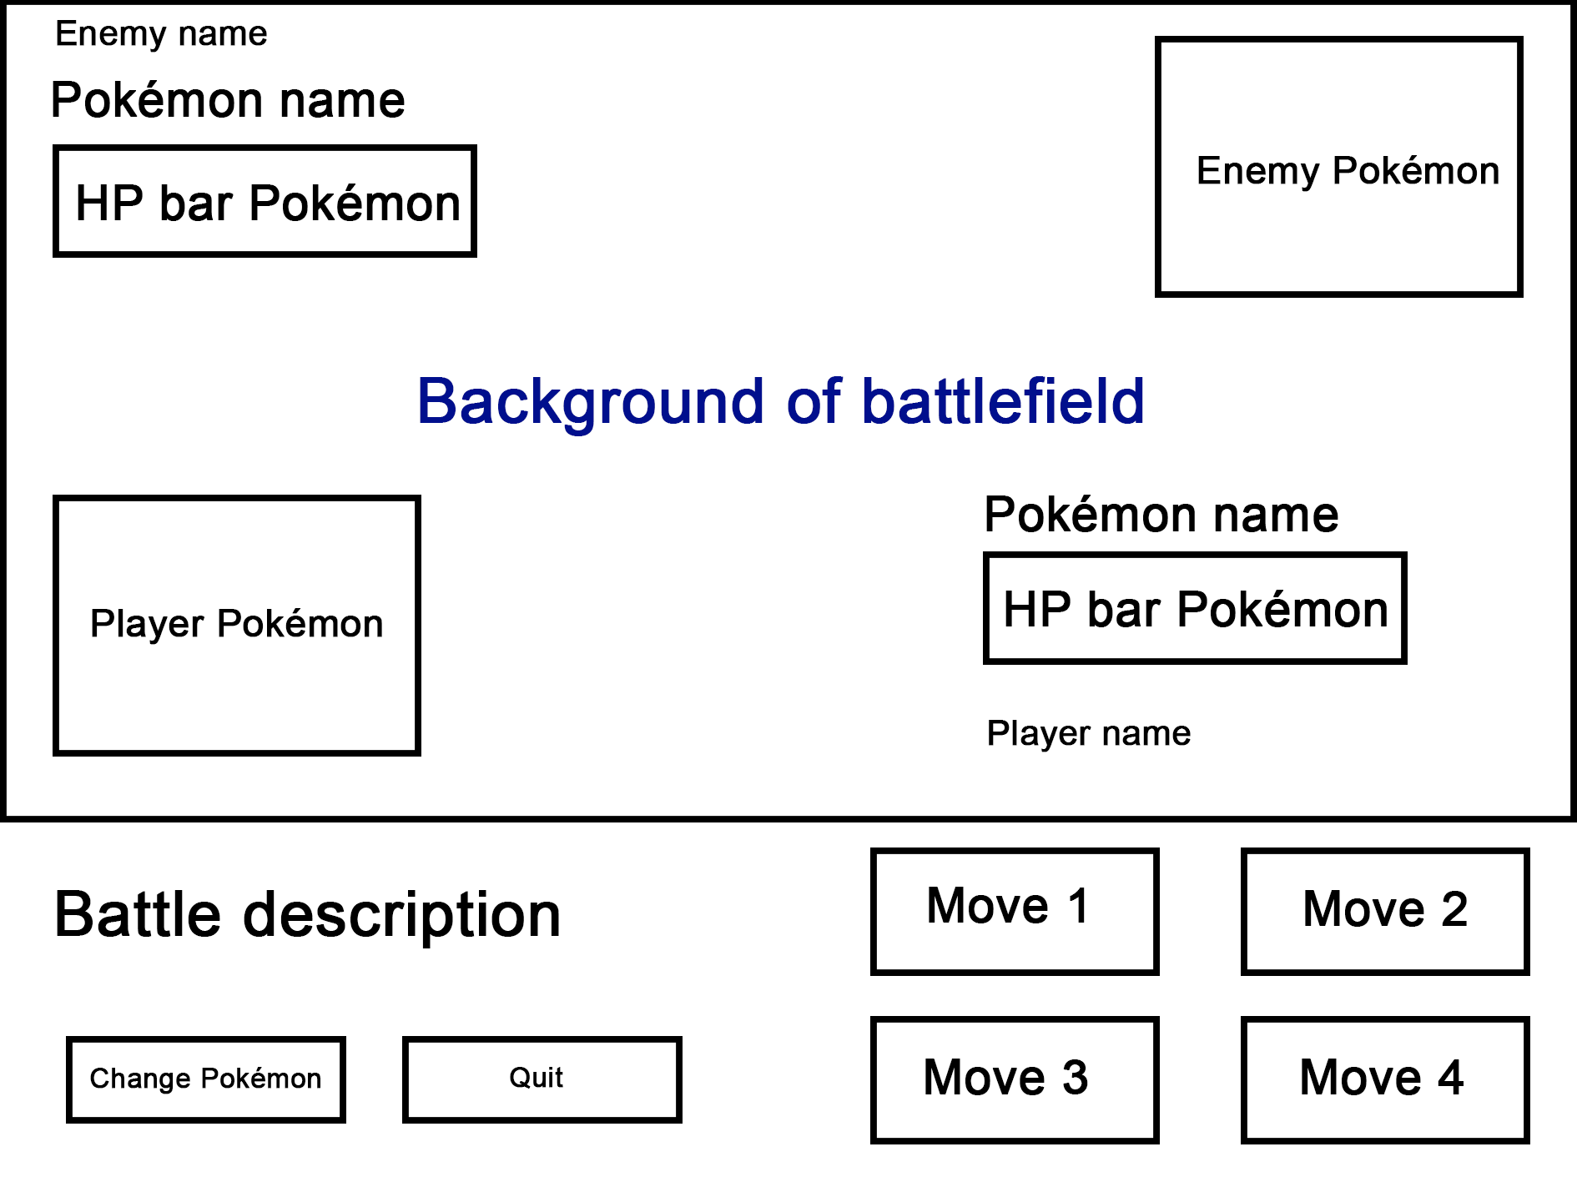
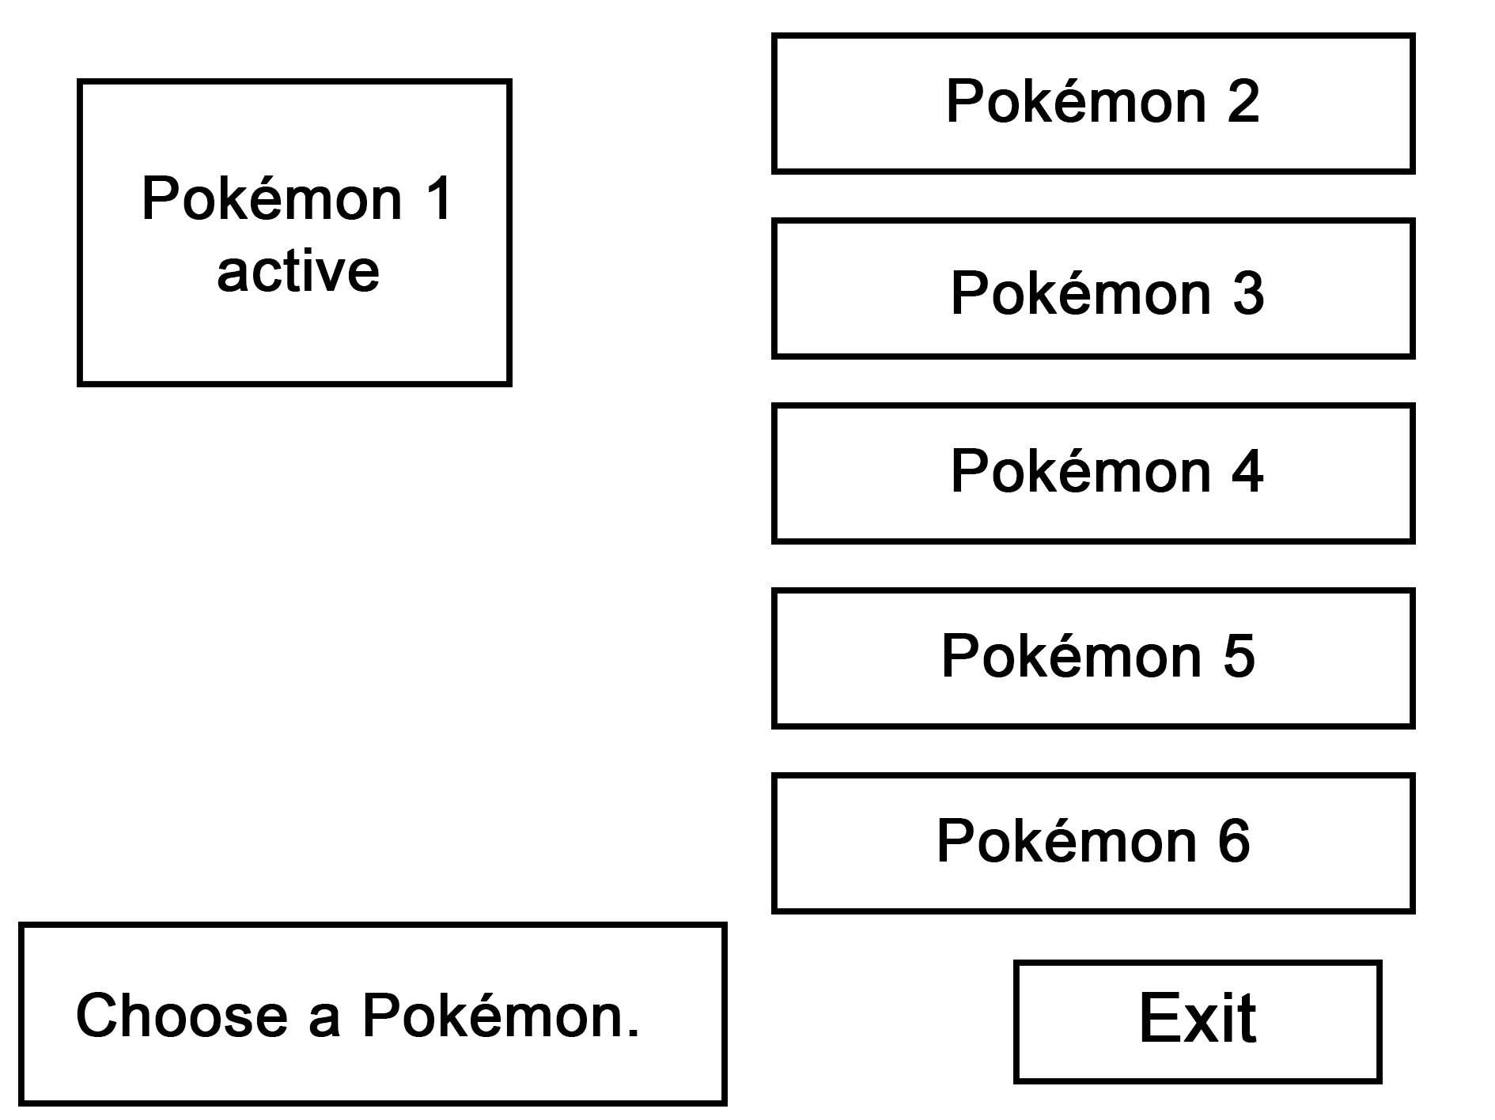
Titolo presentazione
arial bold 8 pt
Luogo e data arial regular 8 pt
Wireframes
1
2
3
4

Slide 7
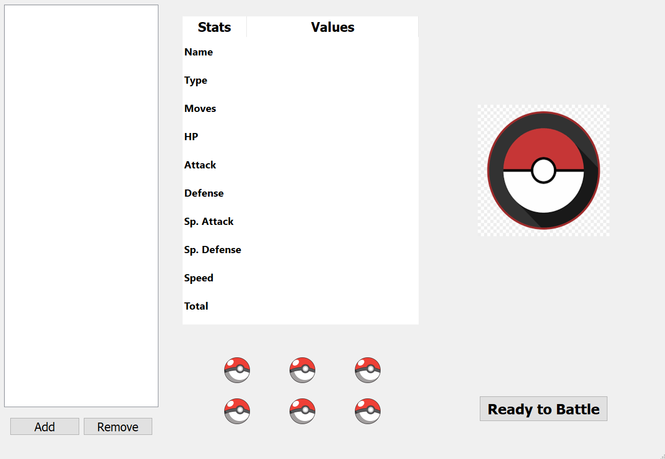
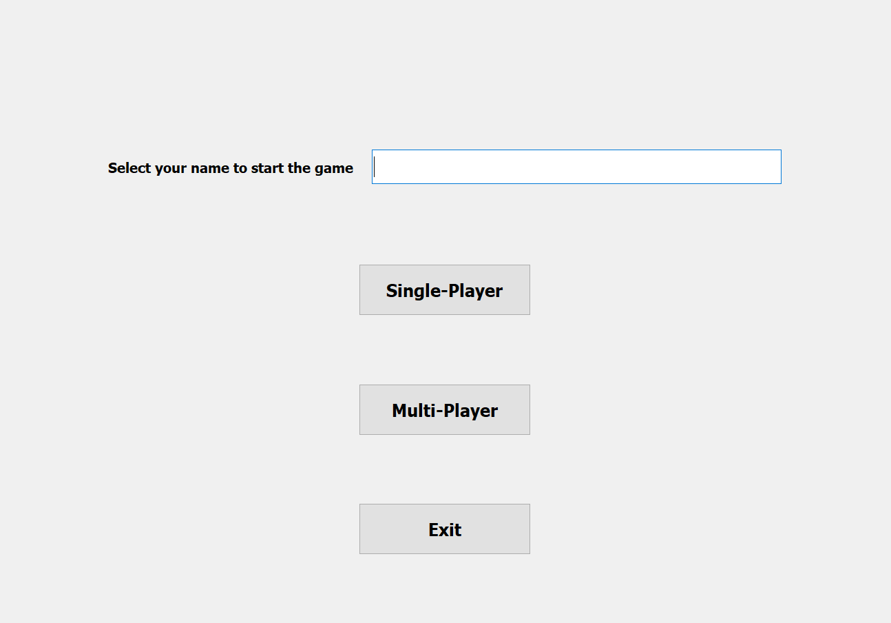
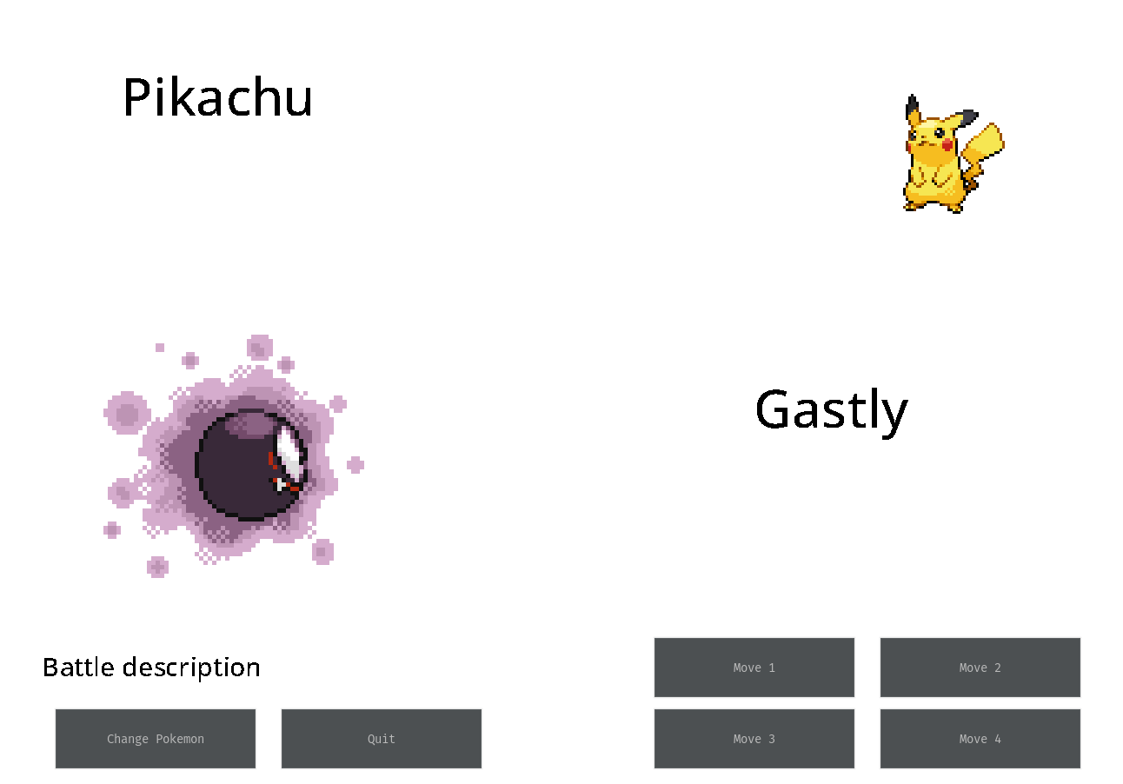
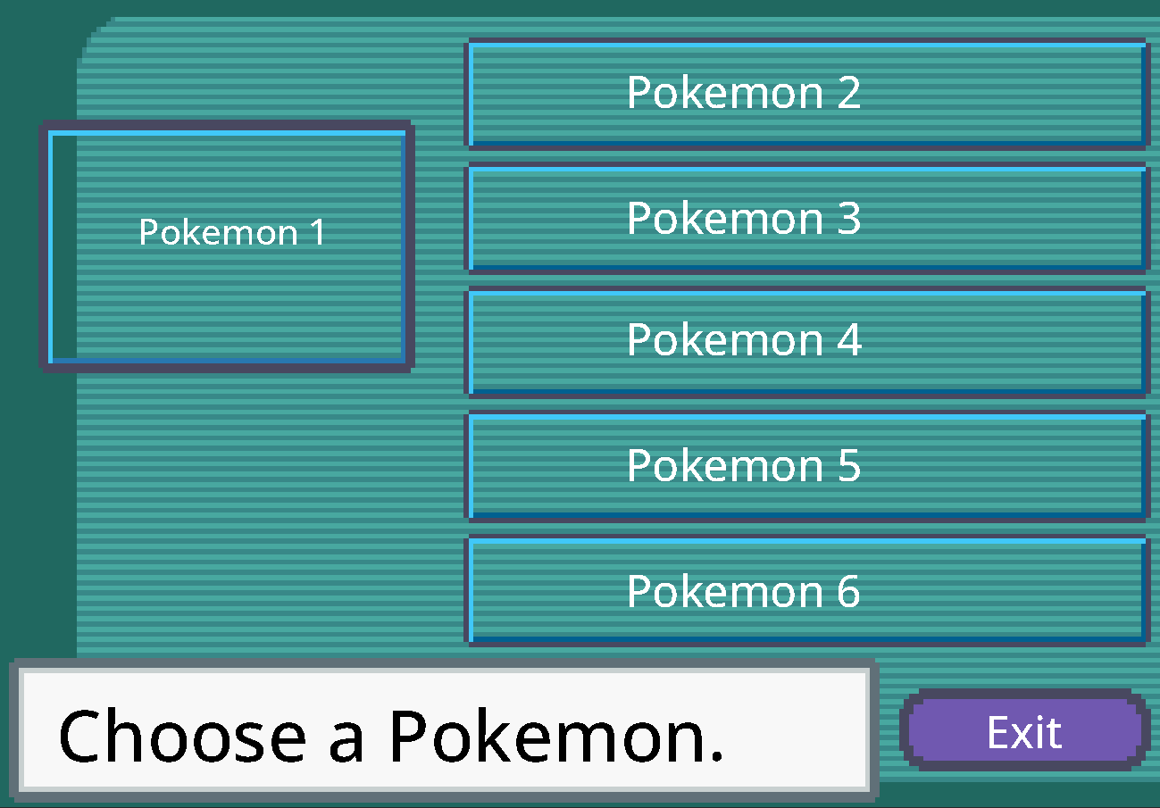
Titolo presentazione
arial bold 8 pt
Luogo e data arial regular 8 pt
Mockups
1
2
3
4

Slide 8
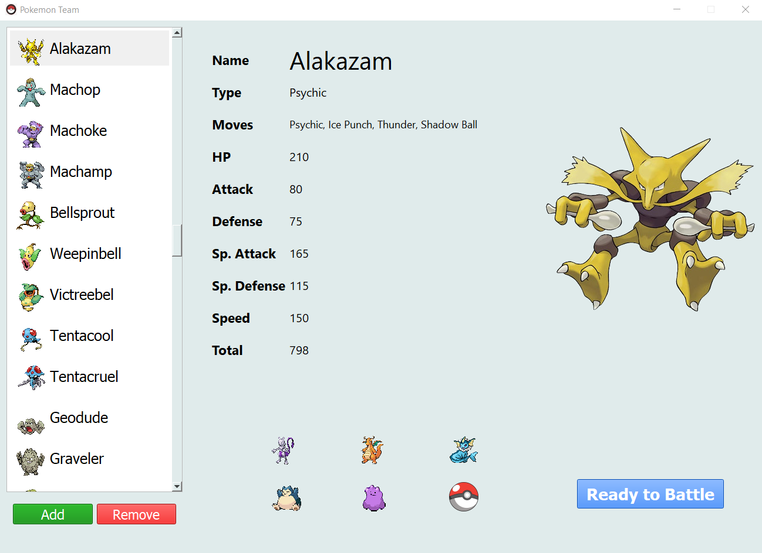
Titolo presentazione
arial bold 8 pt
Luogo e data arial regular 8 pt
Real game – ChoosePokémon
1

Slide 9
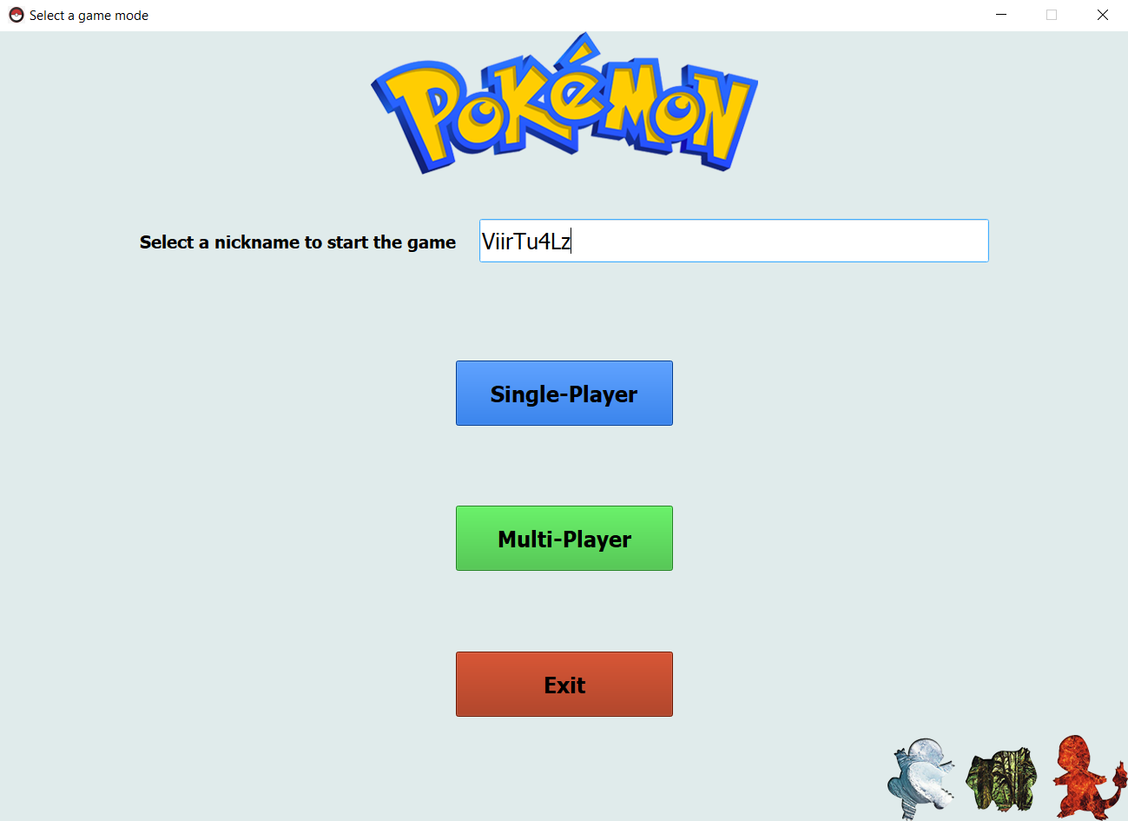
Titolo presentazione
arial bold 8 pt
Luogo e data arial regular 8 pt
Real game – GameModeSelection
2

Slide 10
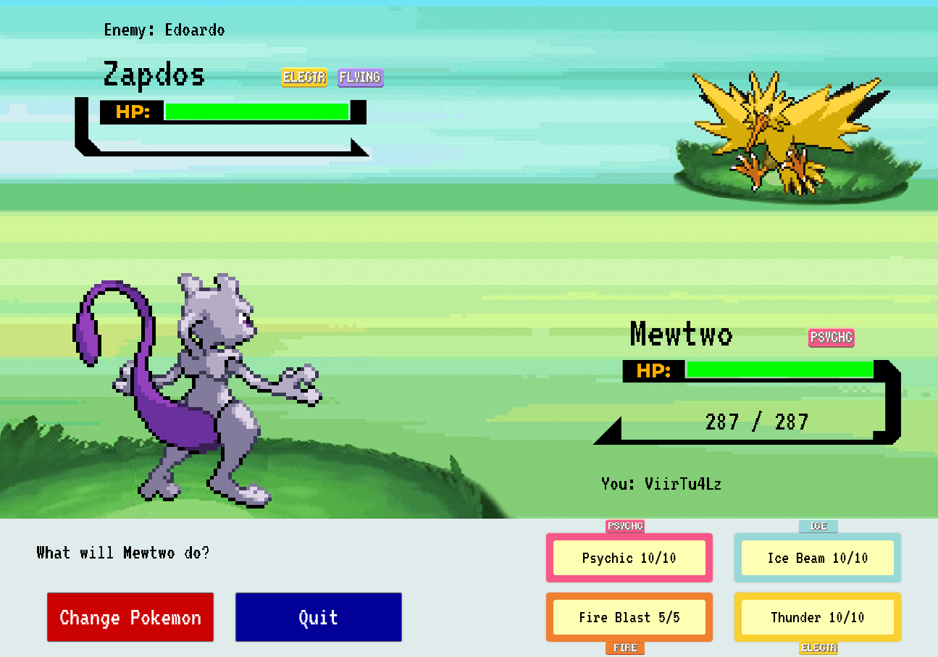
Titolo presentazione
arial bold 8 pt
Luogo e data arial regular 8 pt
Real game - BattleField
3

Slide 11
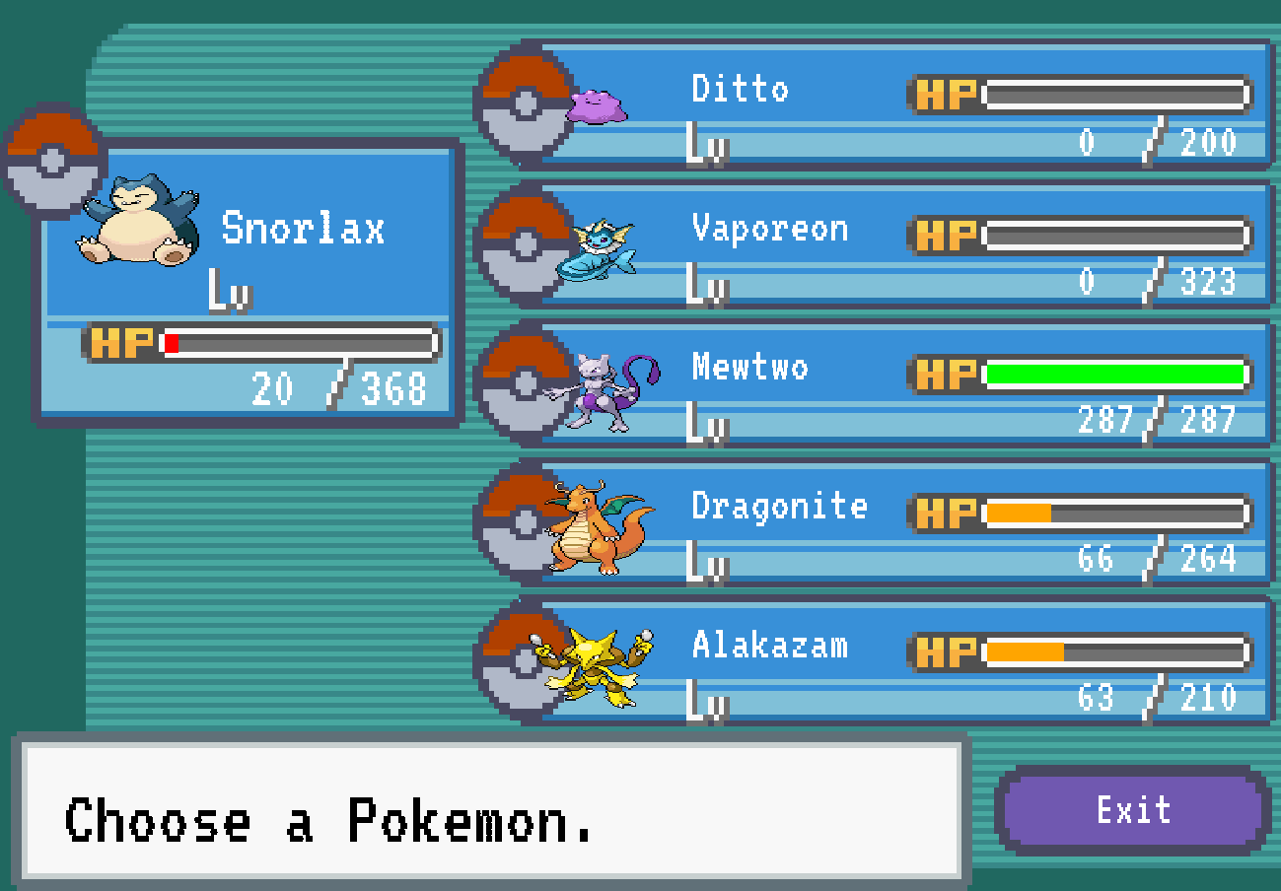
Titolo presentazione
arial bold 8 pt
Luogo e data arial regular 8 pt
Real game - TeamChoiceMenu
4

Slide 12
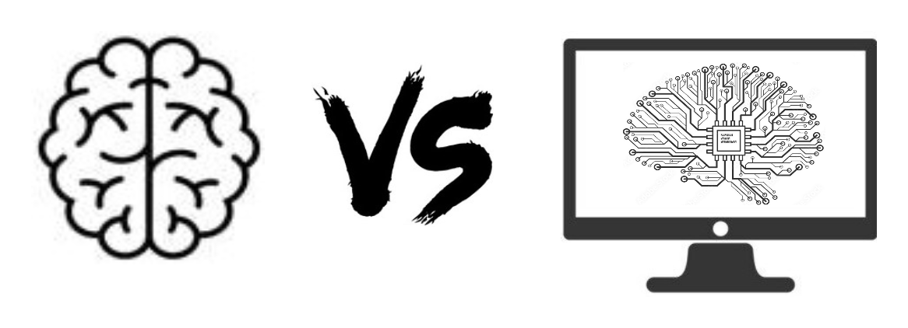
Titolo presentazione
arial bold 8 pt
Luogo e data arial regular 8 pt
Singleplayer mode
The singleplayer mode consists of a battle between the trainer and the CPU, in fact this allows an user to train itself and learn all the strategies and techniques present around these Pokémon battles.
The CPU is not extremely smart, it is assigned a random team for the match and its Pokémon makes moves always in a random way in order to not be too difficult for a beginner. Therefore, the idea is that an inexperienced trainer tries this mode, improves and can be ready for real battles with experienced trainers in the multiplayer mode.

Slide 13
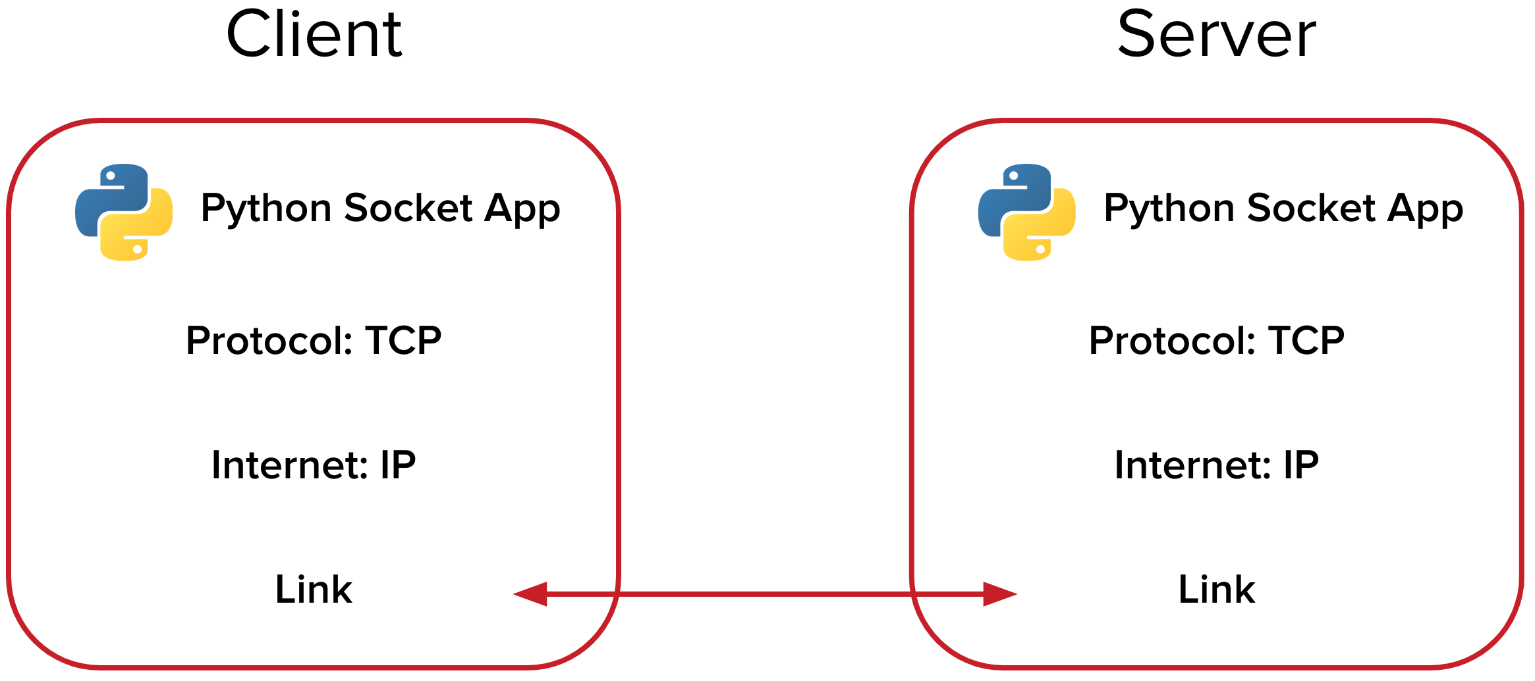
Titolo presentazione
arial bold 8 pt
Luogo e data arial regular 8 pt
Multiplayer mode - Server
The multiplayer mode consists of a fight between two different trainers. To do this, it is necessary to start a server that allows to manage the communication between the two clients.
In particular, in python there is the library socket that allows to define a communication of this type. When the server is started, it defines its IP (local or global depending on its use), its port and the maximum number of clients that can connect to it at the same time.
The server waits for possible client requests to initiate communication and when it receives a request, it will execute a thread that will allow to manage the communication between that particular client and the server itself.
Notes:
As previously mentioned, in our case the clients connected to the server must necessarily be two, so the server as soon as it receives a message from one of them will forward it to the other.

Slide 14
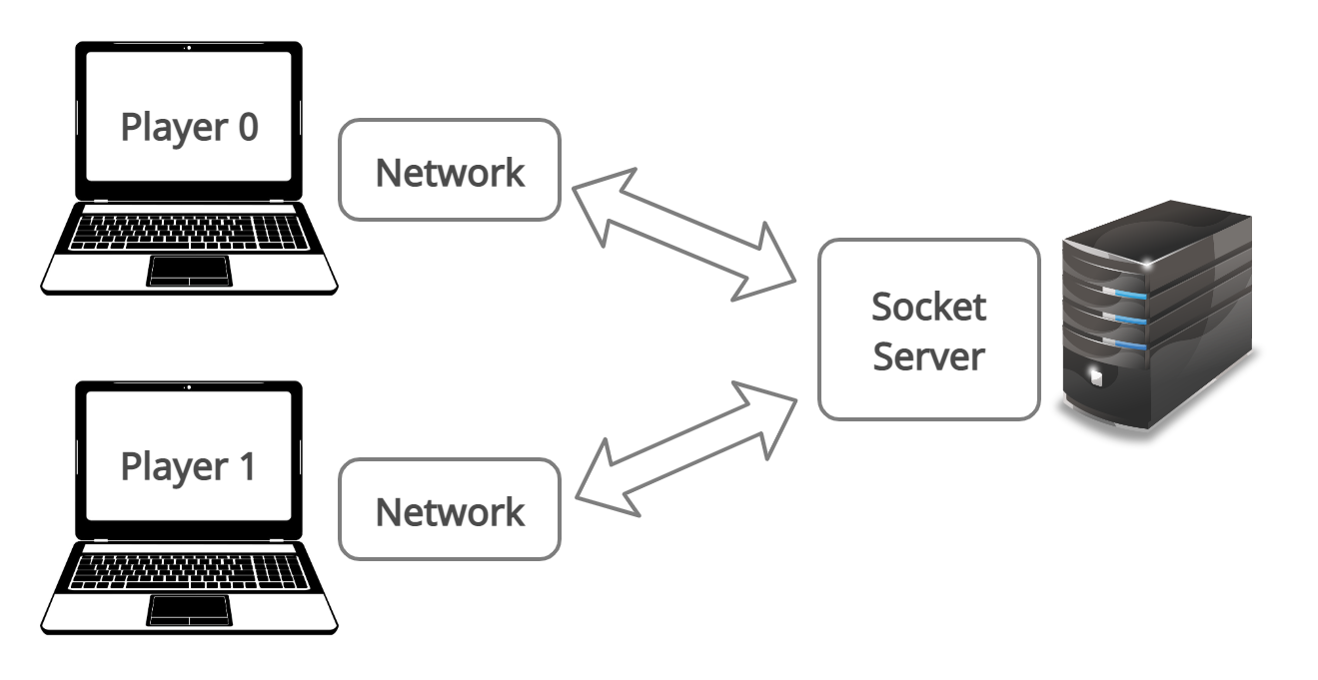
Titolo presentazione
arial bold 8 pt
Luogo e data arial regular 8 pt
Multiplayer mode - Clients
A client to be able to connect with the server must use a custom Network instance that requires the IP and port of the server to initiate a communication.
The client, after having sent the first packet indicating to the server that it wants to establish a TCP connection, waits for packets from the latter; once the connection between these entities has been set, both exchange empty packets continuously in order not to lose the communication established due to the set timeout.
When a trainer wants to interact with his move or choice towards the other player, the packets exchanged between the server and the clients will no longer be empty but will contain all the information necessary for the game.

Slide 15
Titolo presentazione
arial bold 8 pt
Luogo e data arial regular 8 pt
Multiplayer mode – Messages exchanged
To respect the game turns it is necessary that both trainers send their moves or choices, waiting for the opponent's move if he has not already made them.
The information that the players exchange during the turns to execute the correct performance of the game conceptually concern the updating of the models:
the enemy trainer's name;
the Pokémon team that the enemy chose for the battle;
the kind of choice the enemy made (i.e. the Pokémon move in battle, its possible exchange with another one in the team or quit the game);
the choice of the opposing Pokémon to replace the exhausted one in game.
The custom Message class allows clients to send their moves/choices to the other player, so when a client has to send these information it inserts the content of the message in the data attribute of the class relating to the corresponding player and sets the variable of sending. Once both clients have completed these operations, they will check the data attribute relating to the enemy player and discover his choice.

Slide 16
Titolo presentazione
arial bold 8 pt
Luogo e data arial regular 8 pt
Animations and sounds
We have decided to include animations and sounds within the game to make the game more realistic, indeed, the animations concern various things within the battle:
Visualization of the trainers and the Pokéballs from which the Pokémon come out at the beginning of the game;
Explosions generated by the attack of one Pokémon towards the other;
HP bar decrease slowly;
the Pokémon change in battle with another one;
the animations about the special moves.
Even sound generates a sense of involvement, indeed, we set a soundtrack, a sound for explosions due to attacks and also another one for the victory/defeat of the trainers in order to point out the end of the battle.
Notes:
This also allows us to have a minimum of dynamism within the project because, for example, also the PokemonChoice window has within gifs for the entire Pokédex making everything more likely to the original versions of the game.

Slide 17


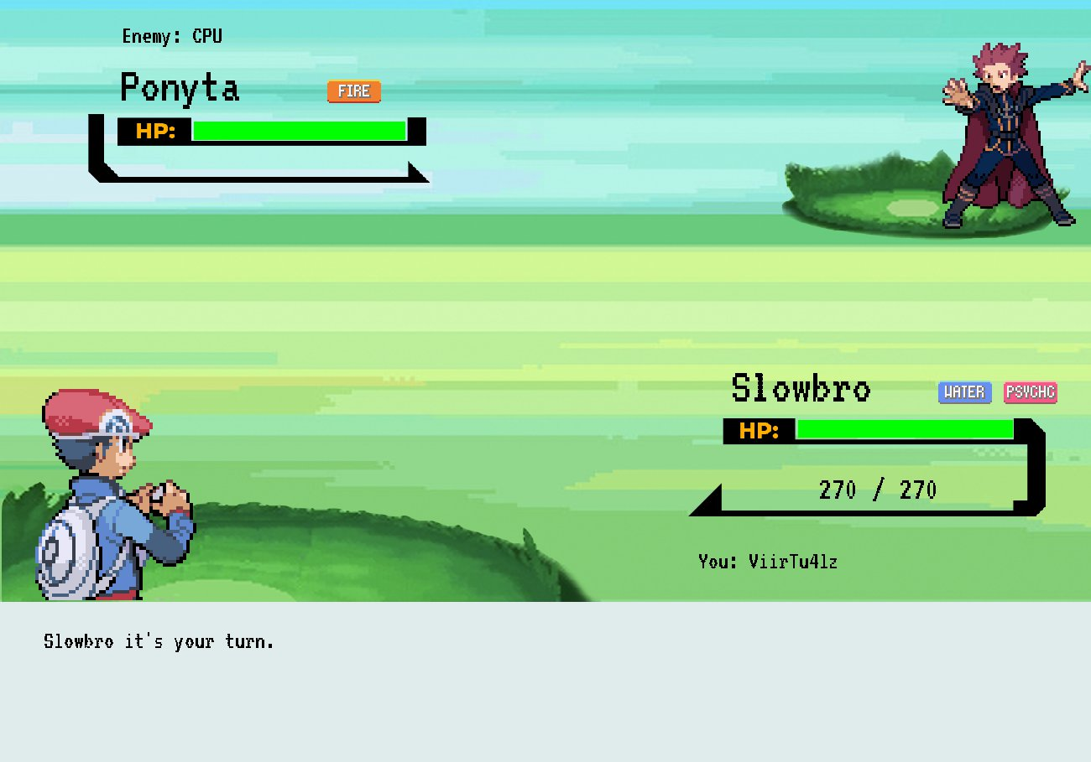
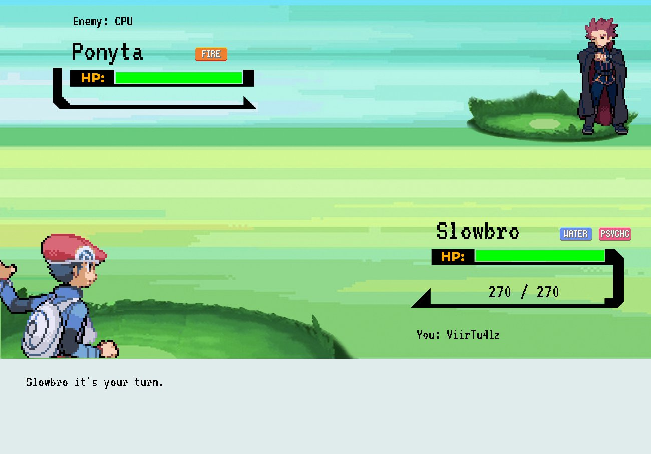
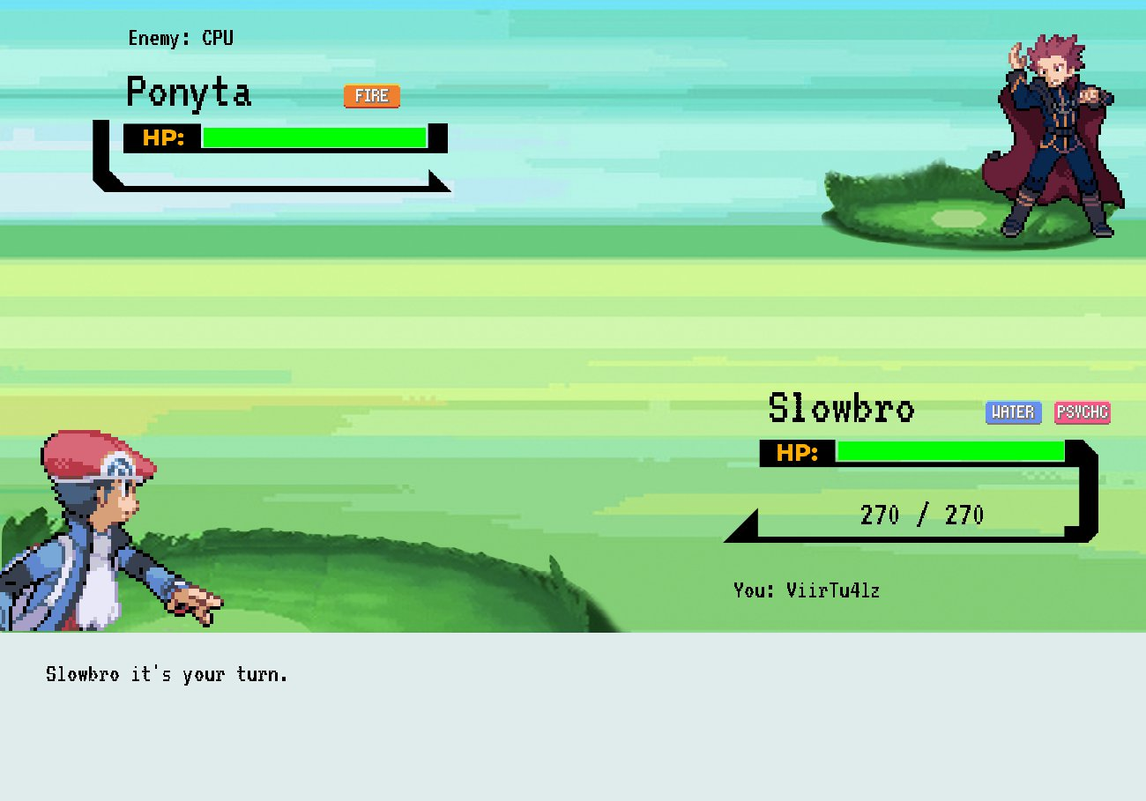
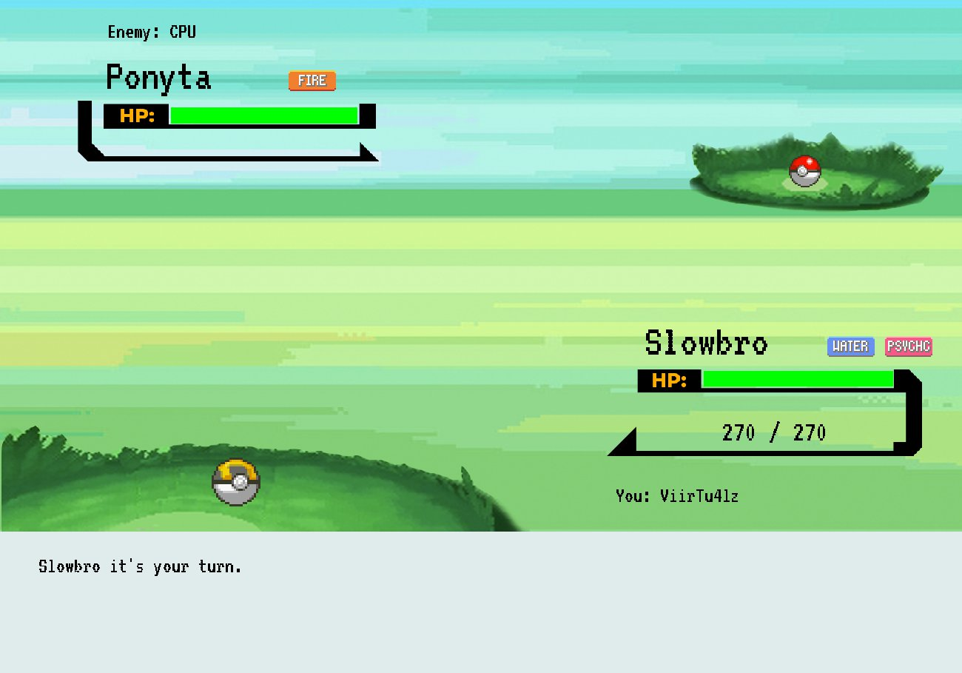
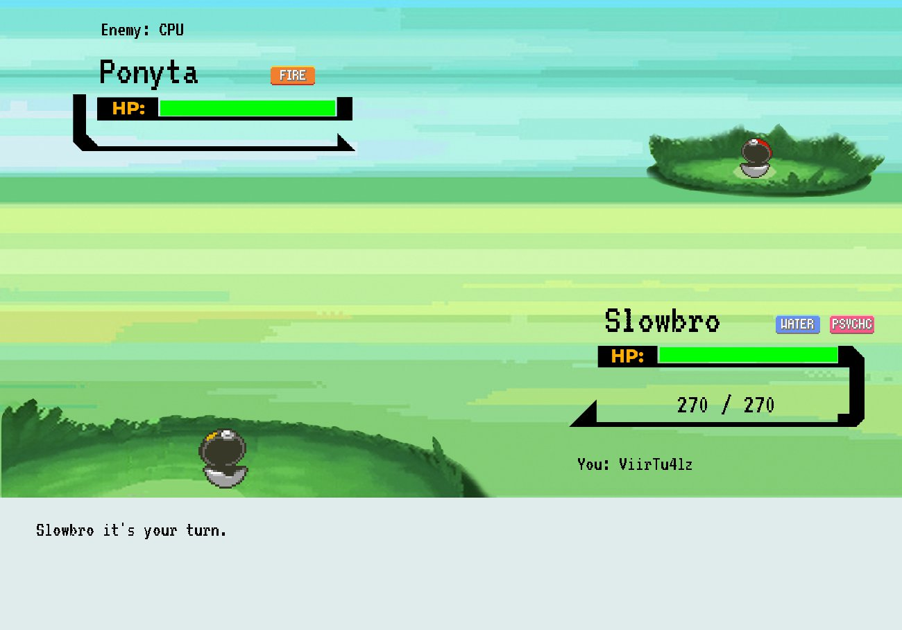
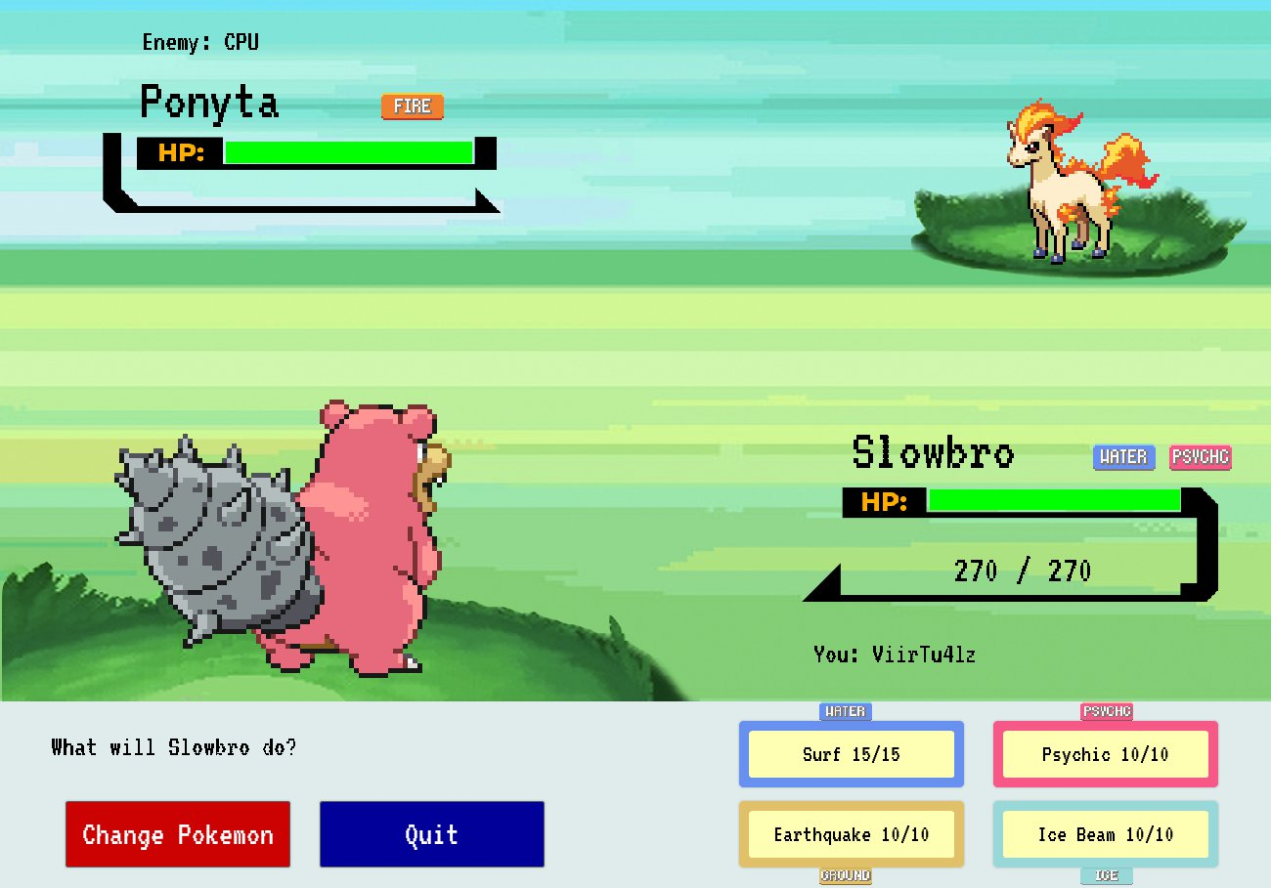
Titolo presentazione
arial bold 8 pt
Luogo e data arial regular 8 pt
Trainers animations

Slide 18
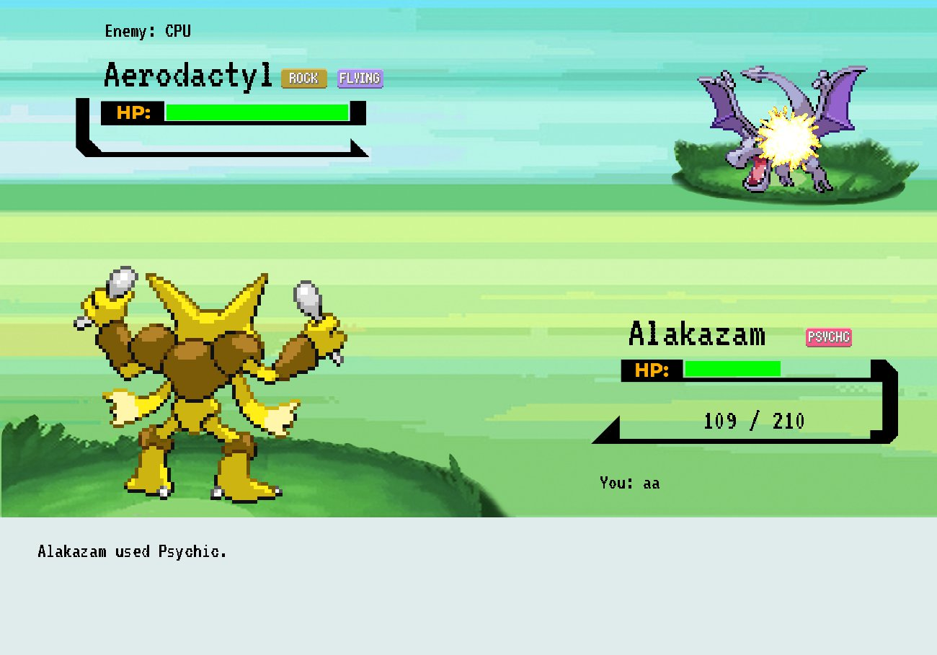
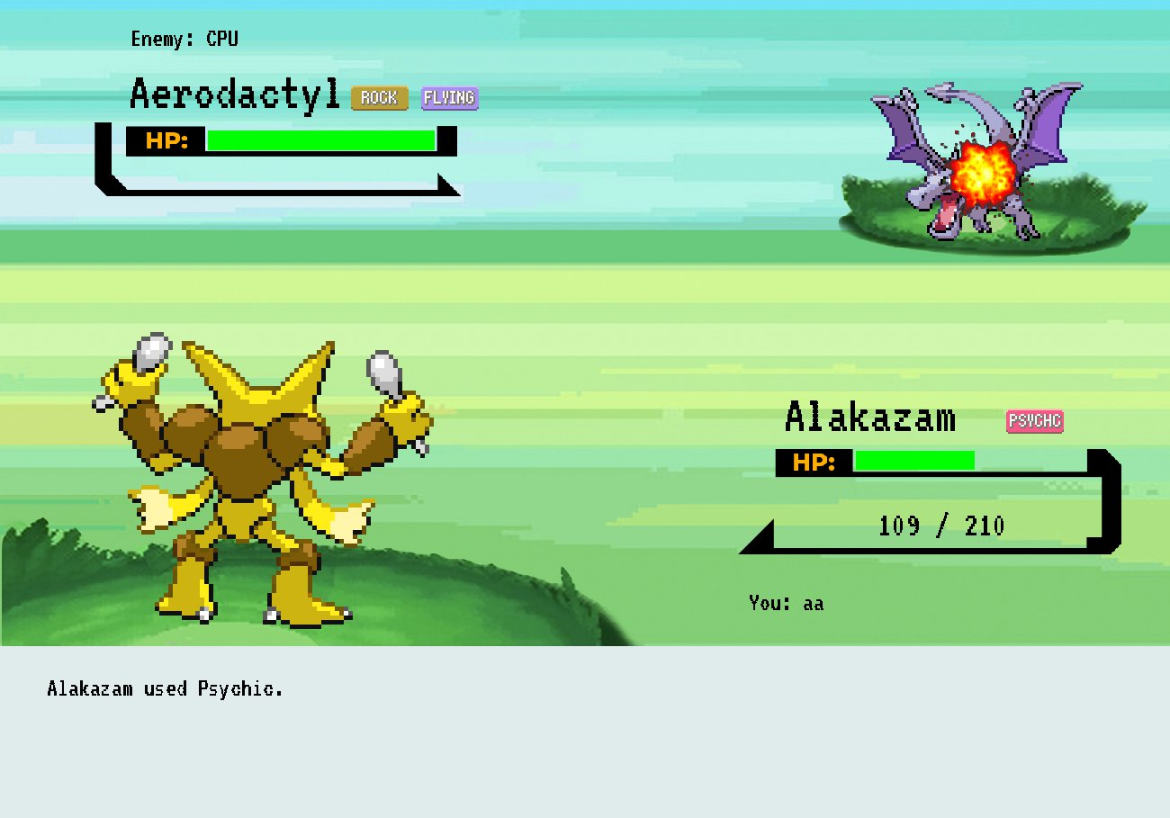
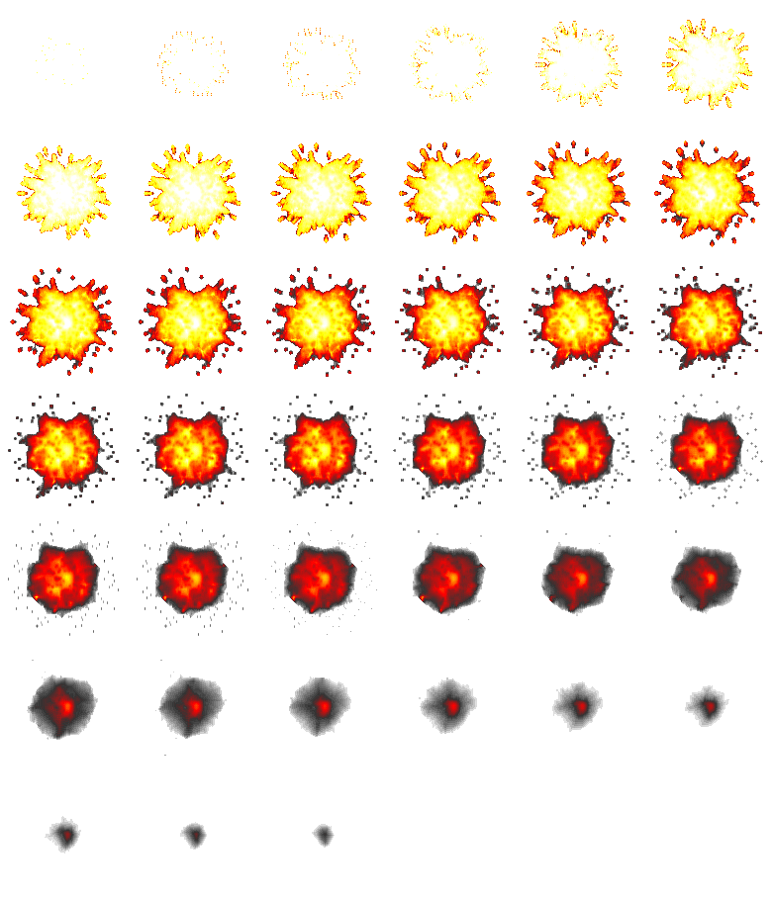
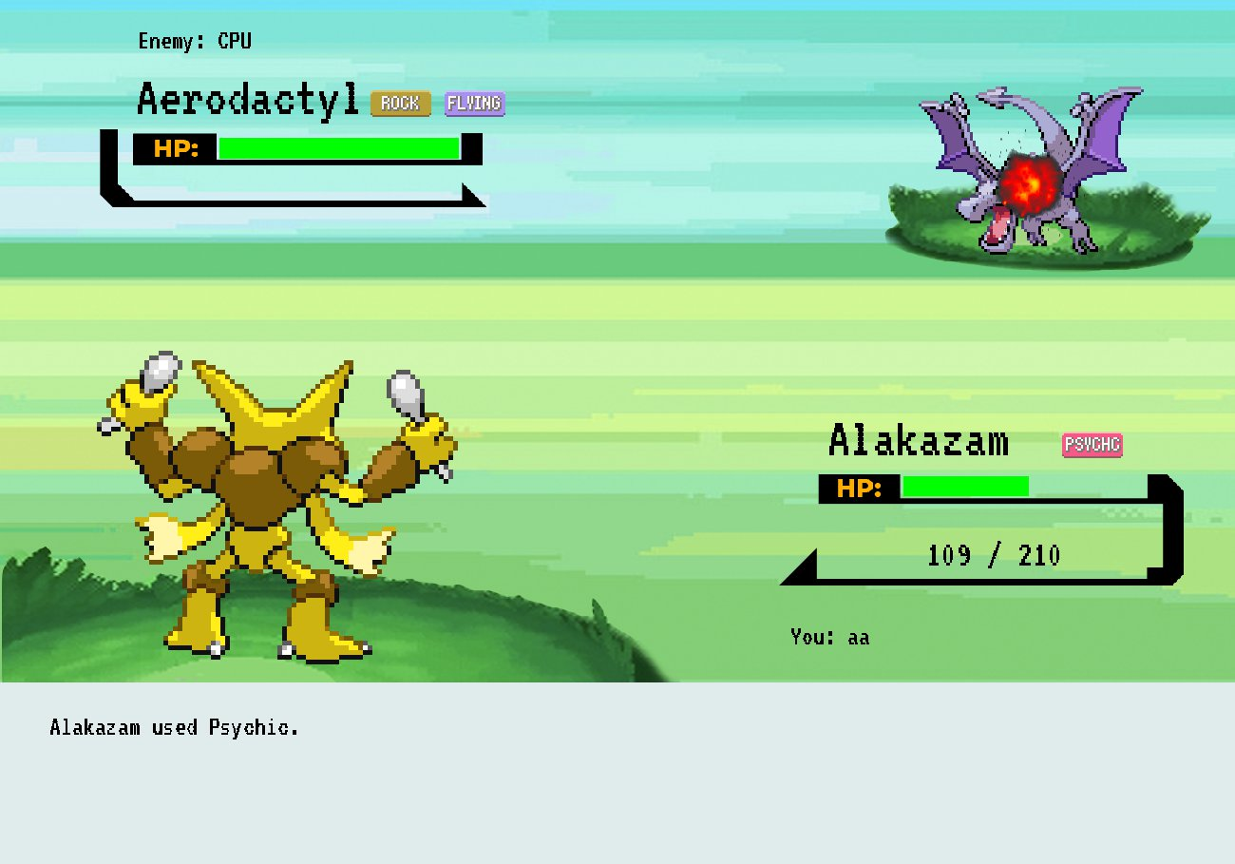

Titolo presentazione
arial bold 8 pt
Luogo e data arial regular 8 pt
Explosion animations

Slide 19
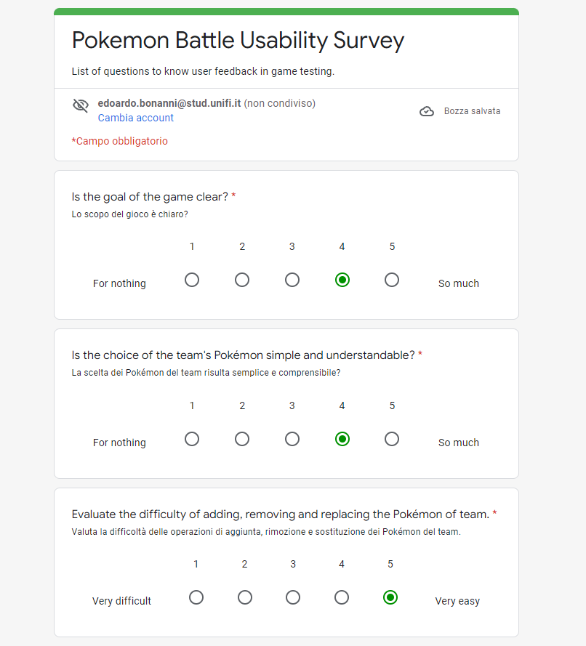
Titolo presentazione
arial bold 8 pt
Luogo e data arial regular 8 pt
Usability tests
The test is structured around a series of questions or statements that the participants had to answer. The questions are SEQs but the range of values ​​is 1 to 5 for us.
Our idea was to have 10 people test our game, taking 5 beginners who have never played a real Pokémon game and 5 people who are experts instead of these games.
We made all these people try the game twice in order to give us evaluations related to the first and second use of the application and trying to diversify these evaluations between expert and beginner trainers.
Notes:
Many questions are SEQs in which the user has to choose a grade from 1 to 5 which serves to measure his user experience,

Slide 20
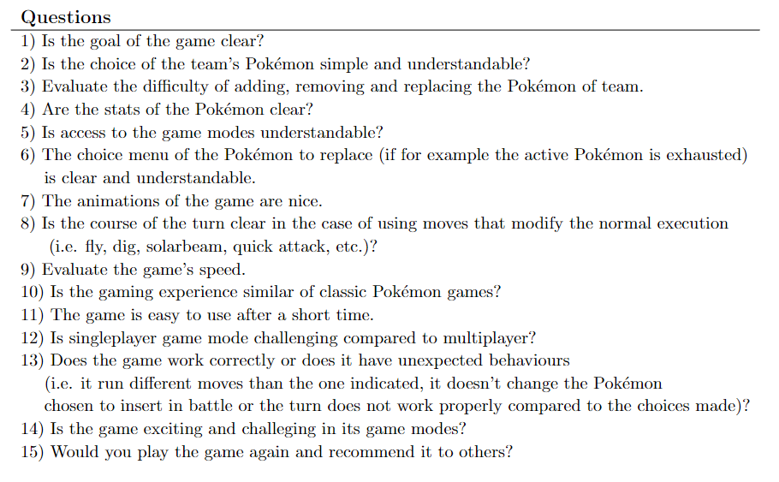
Titolo presentazione
arial bold 8 pt
Luogo e data arial regular 8 pt
Usability tests
Notes:
Many questions are SEQs in which the user has to choose a grade from 1 to 5 which serves to measure his user experience,

Slide 21
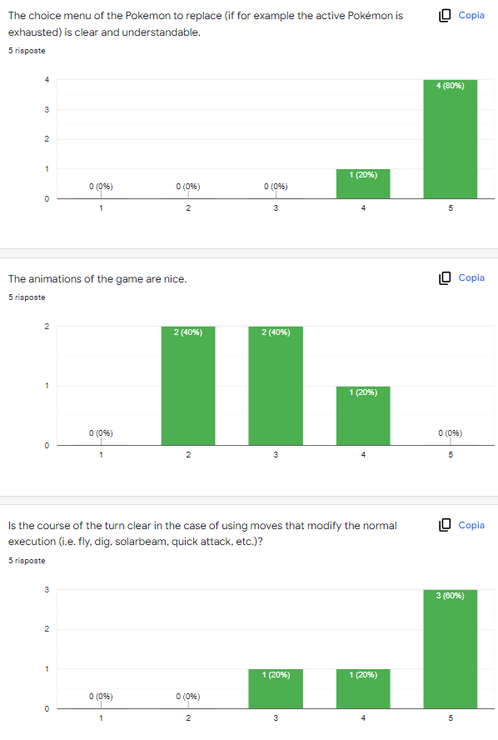
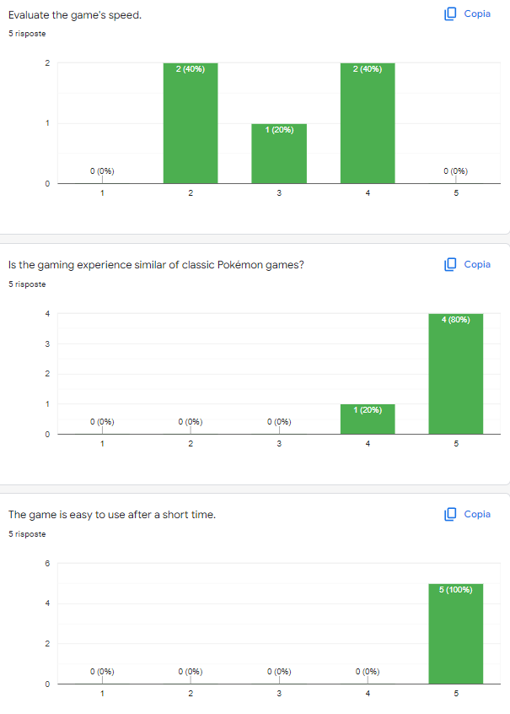
Titolo presentazione
arial bold 8 pt
Luogo e data arial regular 8 pt
Usability tests - stats
Notes:
Many questions are SEQs in which the user has to choose a grade from 1 to 5 which serves to measure his user experience,

Slide 22
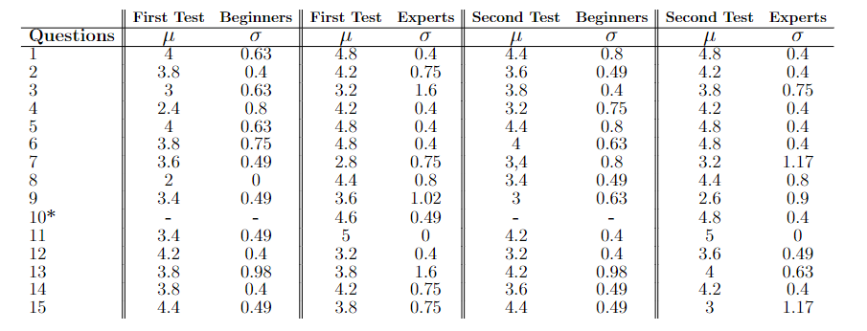
Titolo presentazione
arial bold 8 pt
Luogo e data arial regular 8 pt
Usability tests - results
Table shows the results of first and second test for beginners and experts players. For each question/statement we show the mean rating (µ) and the standard deviation (σ). The results are preceded by the questions/statements made in the usability tests to the players. *Question asked only for experts trainers.

Slide 23
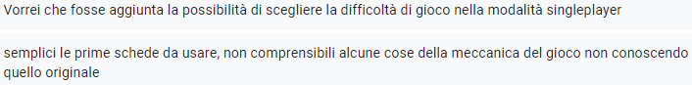
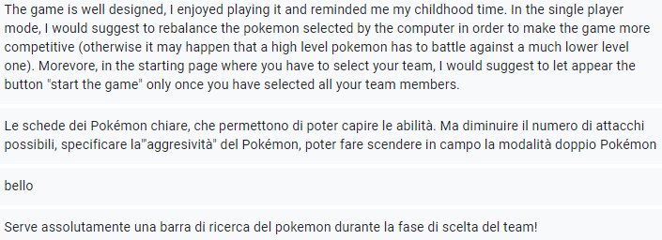
Titolo presentazione
arial bold 8 pt
Luogo e data arial regular 8 pt
Users advices

Slide 24

Titolo presentazione
arial bold 8 pt
Luogo e data arial regular 8 pt
Conclusions
In conclusion, thanks to the usability tests we were able to understand the critical issues of the application such as insert a bar search to find the Pokémon in the initial list, an option that allows to choose the difficulty of the singleplayer mode, specify other stats and properties of the Pokémon, also some game mechanics are not clear to inexperienced trainers such as the effectiveness of certain moves on some Pokémon.
Despite some problems, the general feedback is very positive, the game was understood, appreciated and enjoyable for different types of users, making us satisfied with the application that we developed for the exam.
Notes:
Surely in future versions we intend to improve all the critical issues that are exposed to us, add new features such as double battle, game difficulties or the full screen mode that gives a greater involvement for Pokémon trainers.

Slide 25
Pokémon Battle Simulator
Human Computer Interaction
Luigi Ariano
Edoardo Bonanni
Florence, 26 April 2022

